Slide 1


Creating characters in Genre Films

Slide 2

Aims and Objectives
Aim: Students will be able to use the conventions of genre to create character for script.
Objectives:
Students should be able to use existing knowledge and apply it using the character sheet and fit it to the specific genre.
Students should be able to create a character in the specific genre and present how they come up with this character.
Students should be able to identify the conventions used to create characters in genre films.

Slide 3
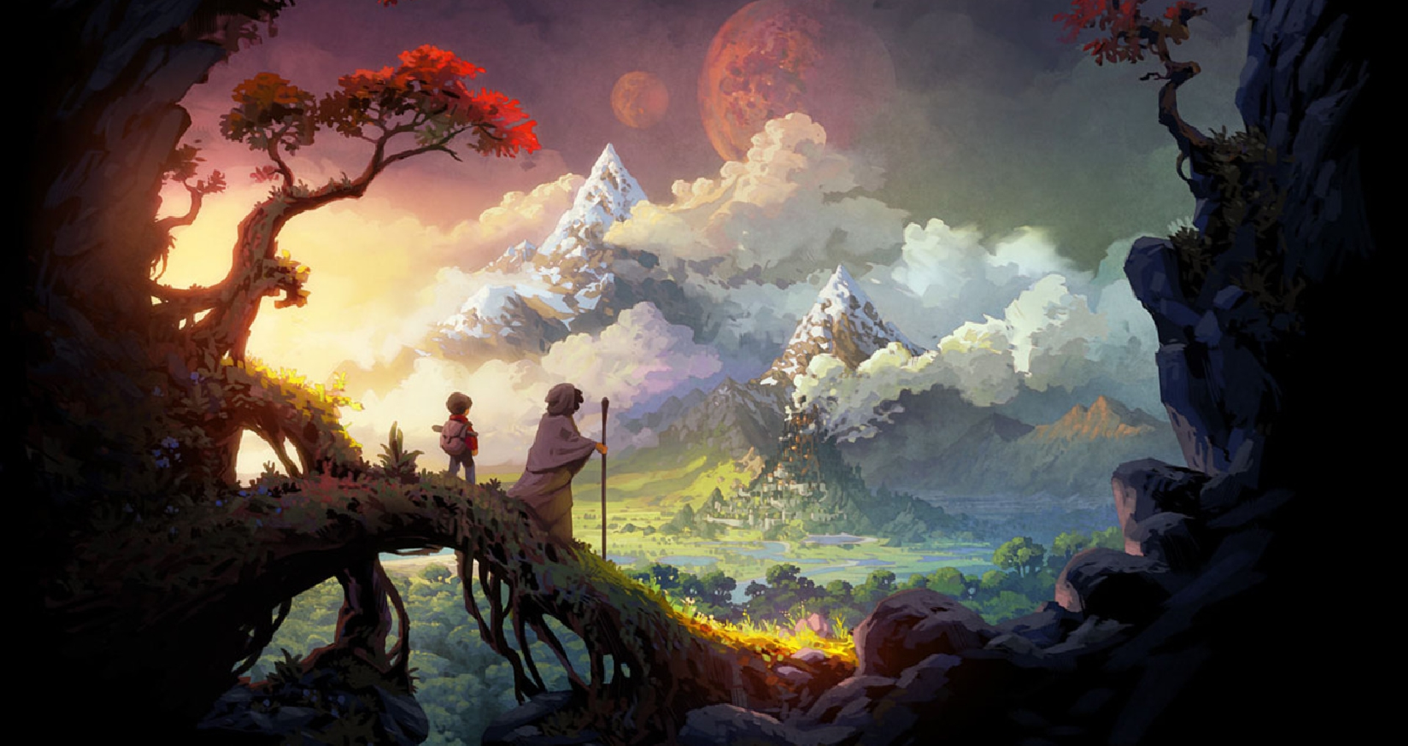
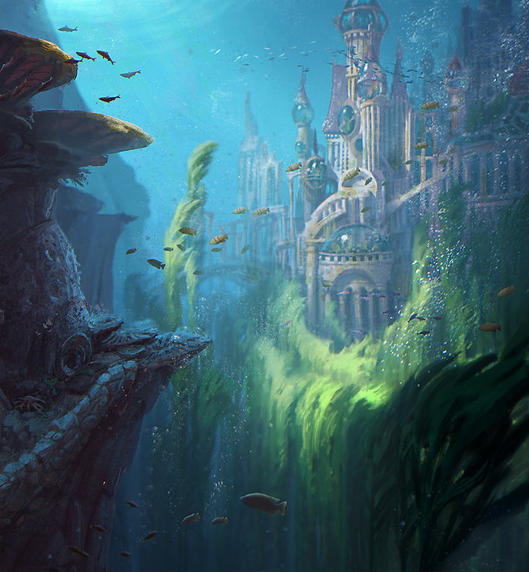
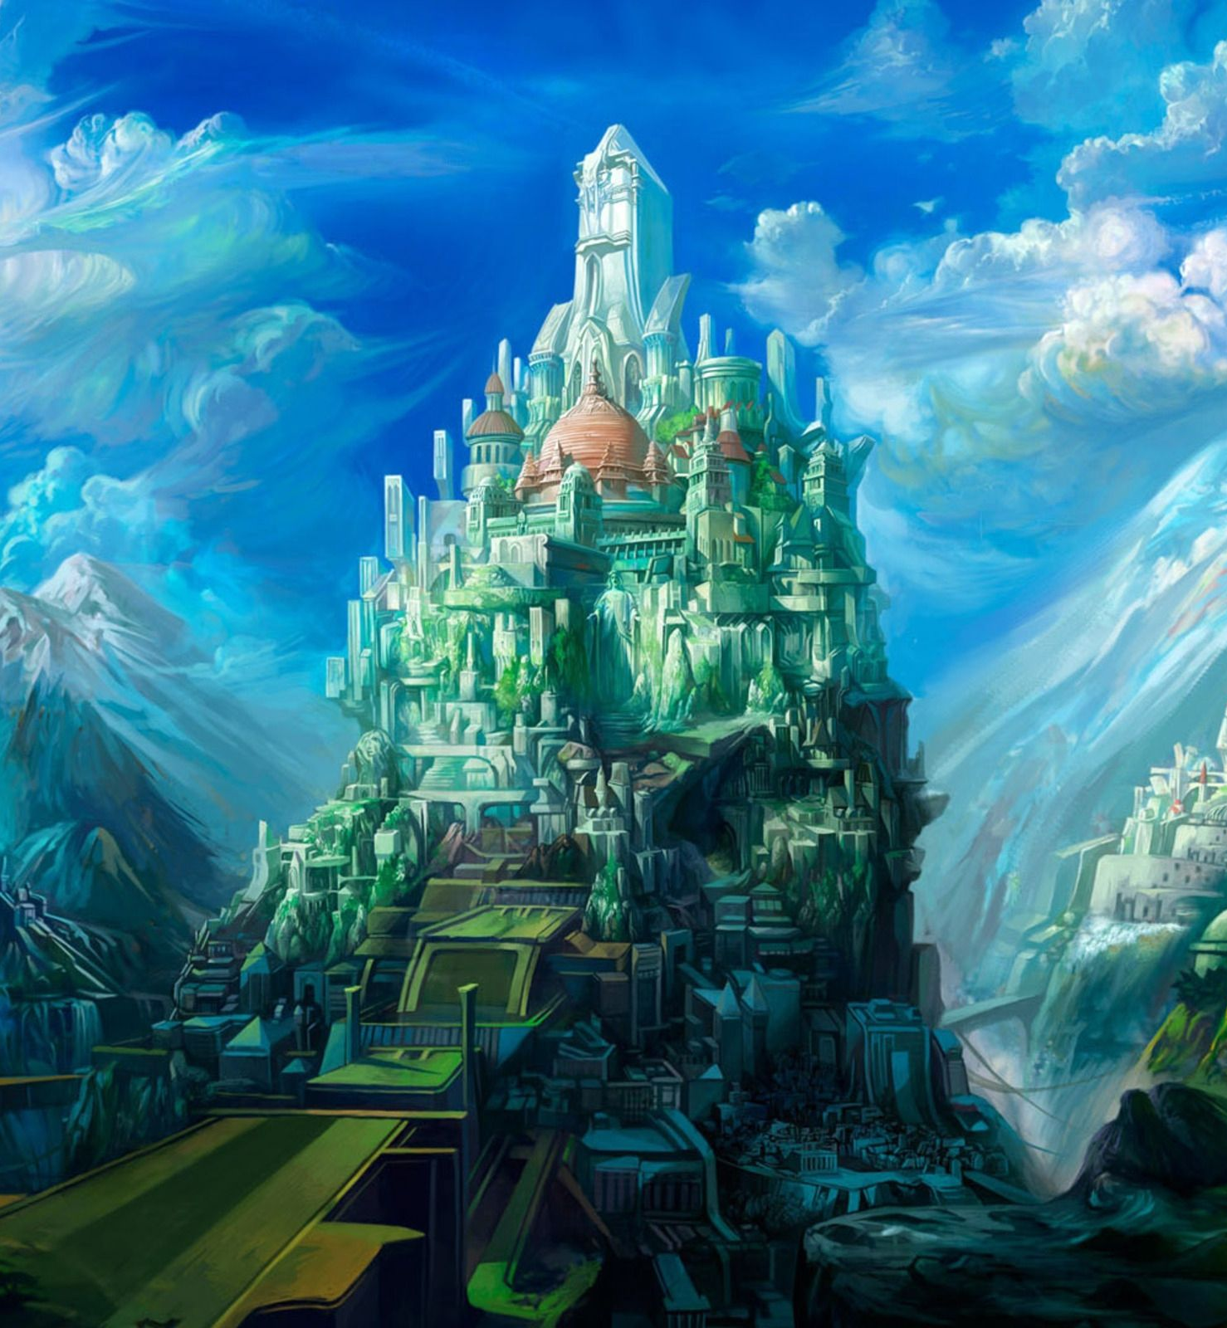
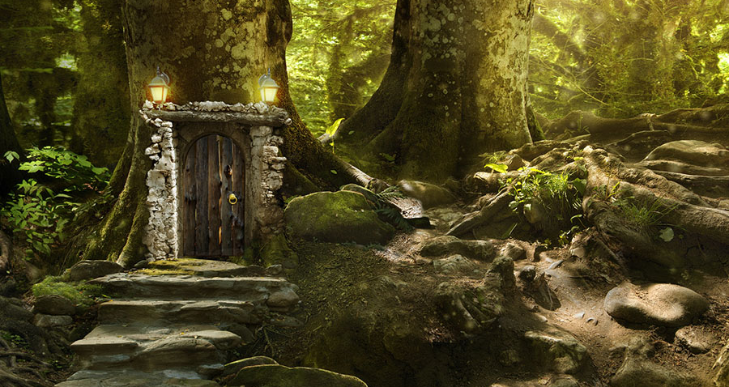
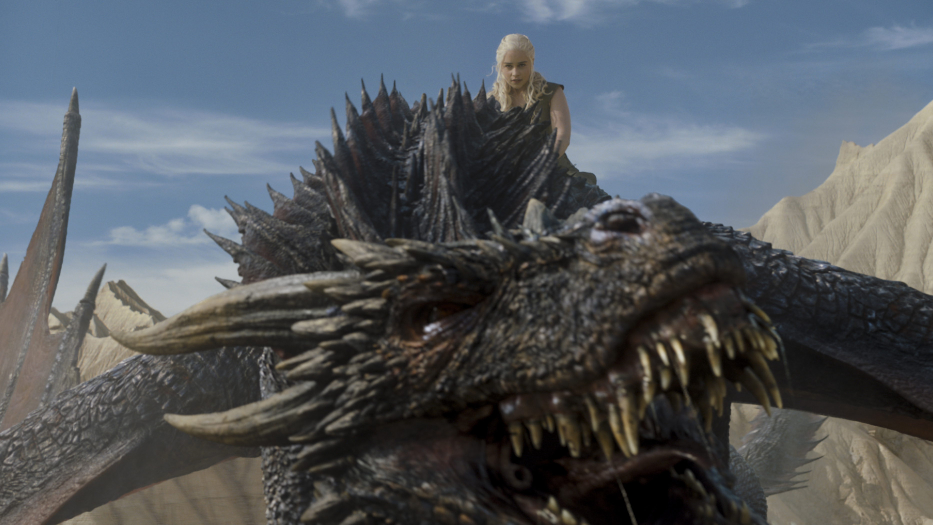
Fantasy Genre

Slide 4
Characterisation
Is your protagonist an ordinary person or possessed of extraordinary powers in some way that help her fulfil her destiny?
Is your protagonist more of a traditional hero or is he or she an antihero? In other words, does your protagonist display typical qualities such as courage, loyalty and goodness, or does the protagonist have a dark side?
Fantasy-type films might also include quasi-religious or supernatural characters such as angels, lesser gods, or fairies. Or they include the gnomes, dwarves and elves of legend

Slide 5
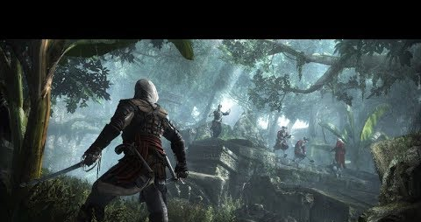
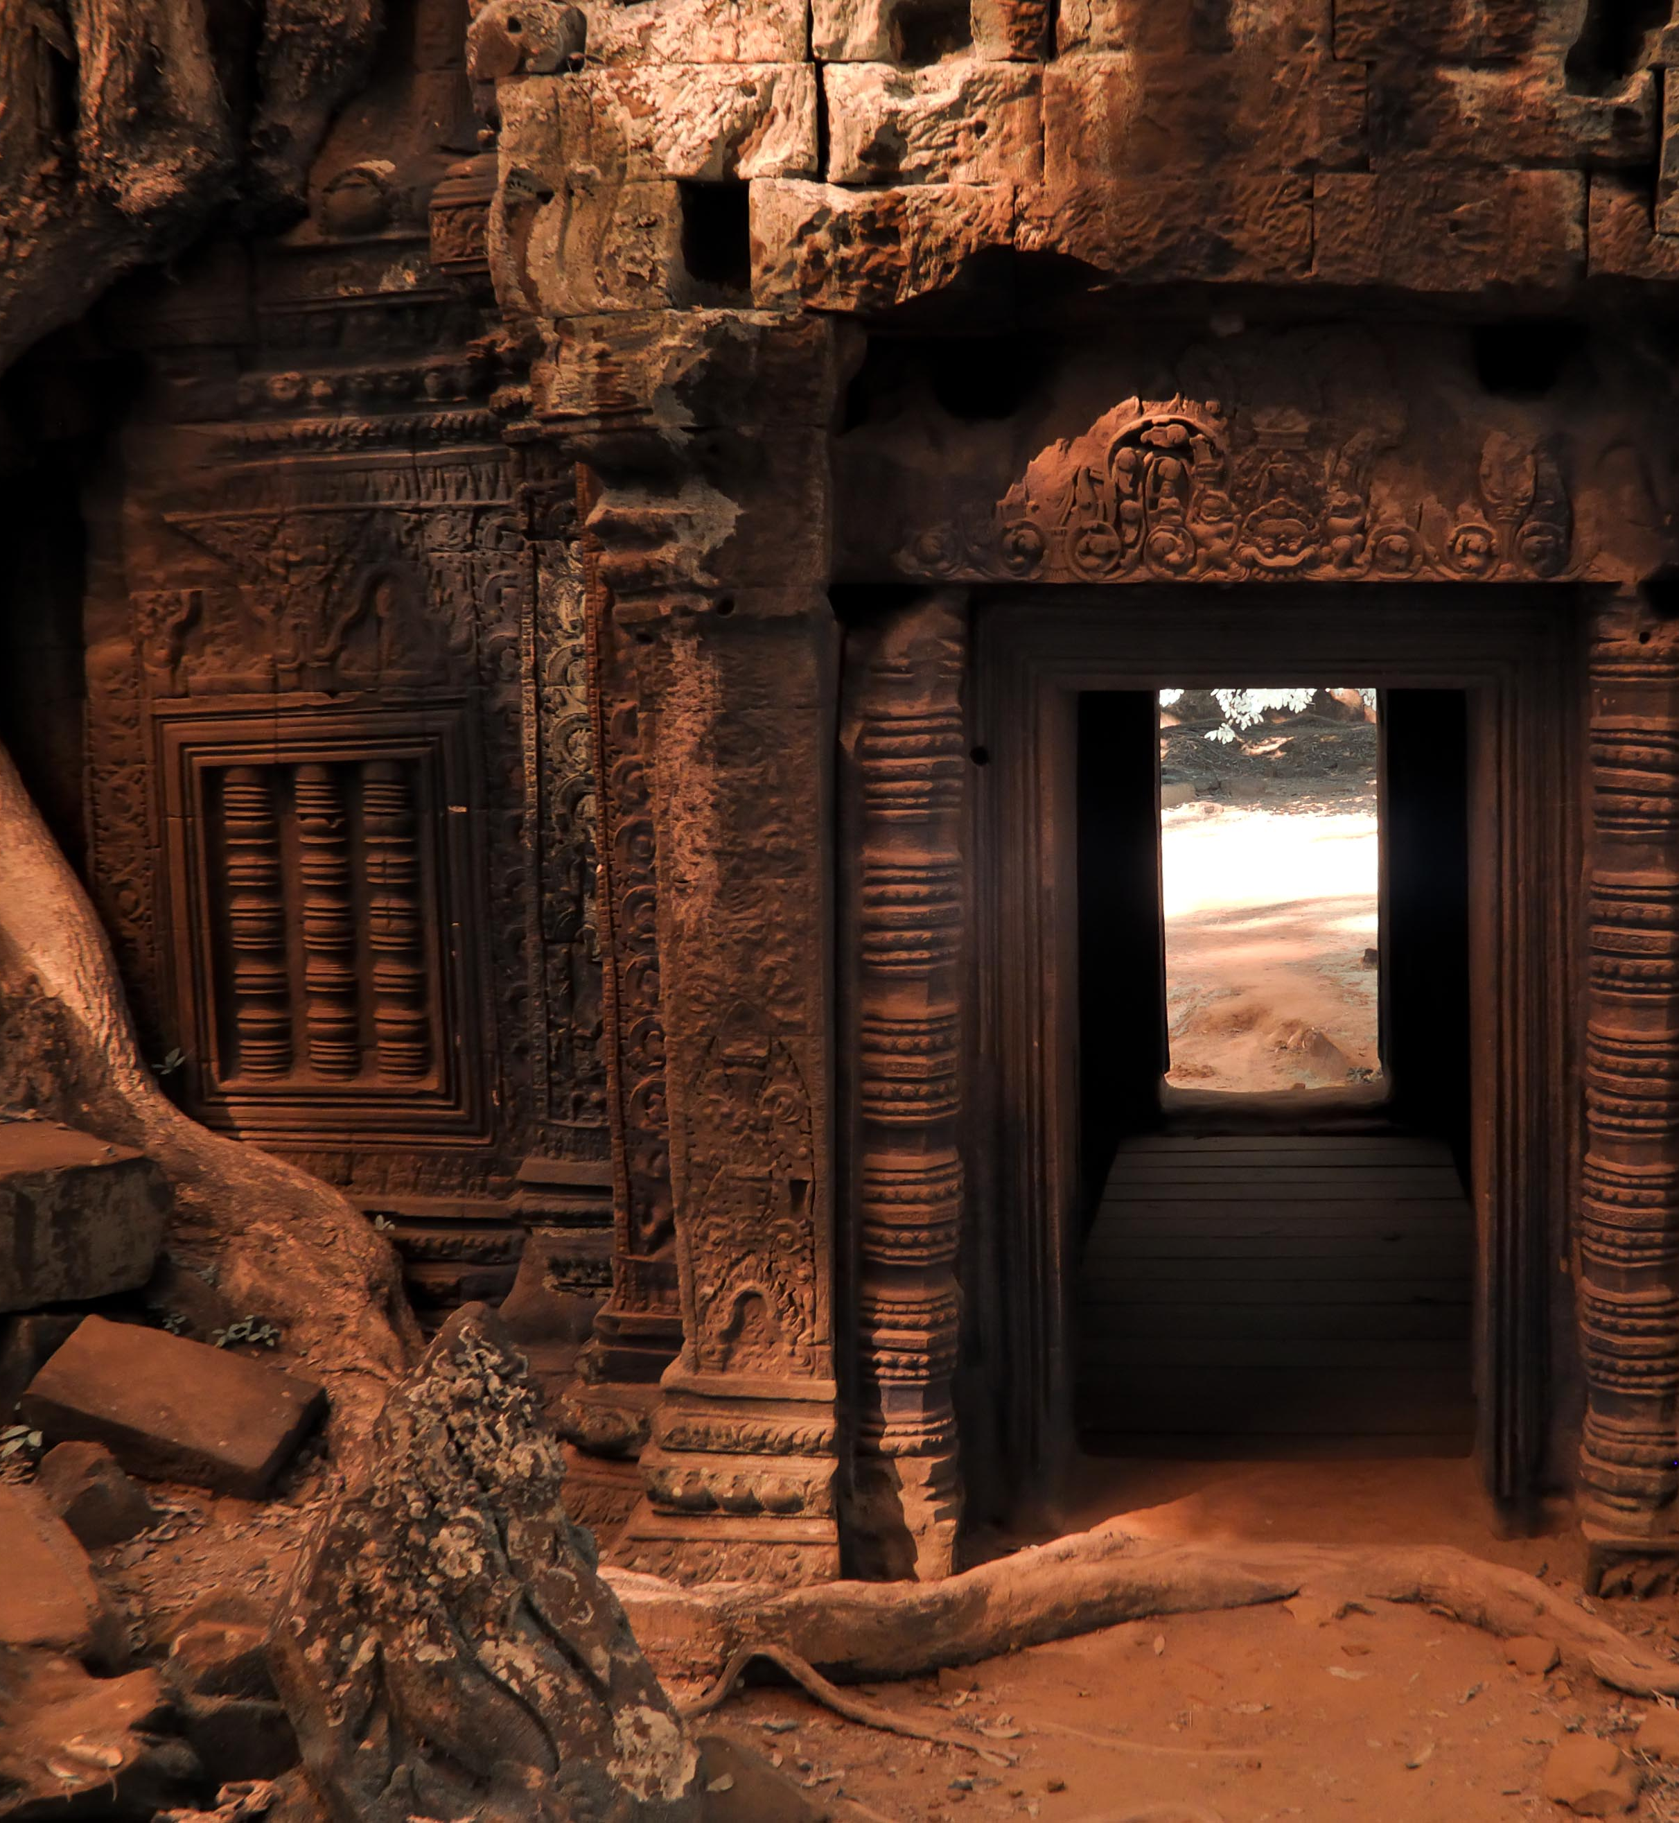
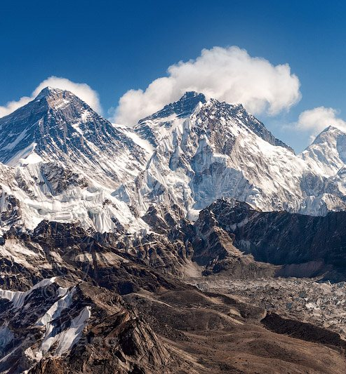
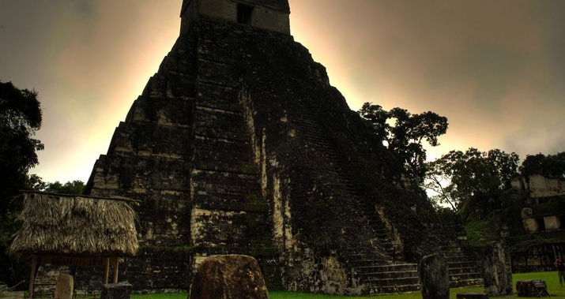
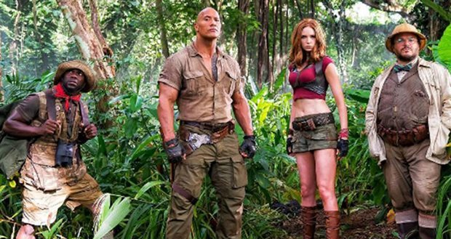
Adventure

Slide 6
Characterisation
The stereotypical hero, is usually a American man. The hero, generally has muscular attributes and is good looking, often attracting female attention. The hero, is good at fighting the Villain and can usually out wit them
These courageous, patriotic, or altruistic heroes often fought for their beliefs, struggled for freedom, or overcame injustice.
Modern adventure films, some of which have been successful blockbusters, have crossed over and added resourceful action heroes (and oftentimes heroines)

Slide 7
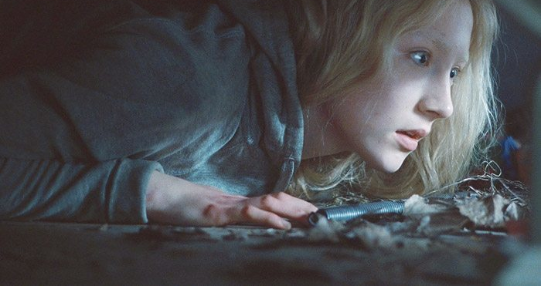
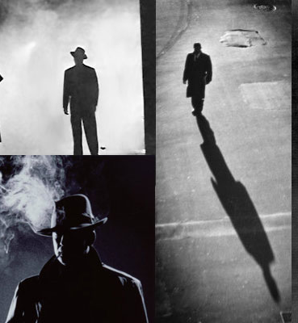
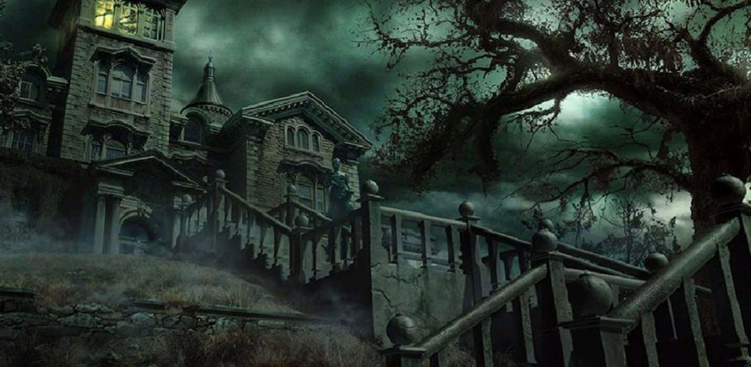
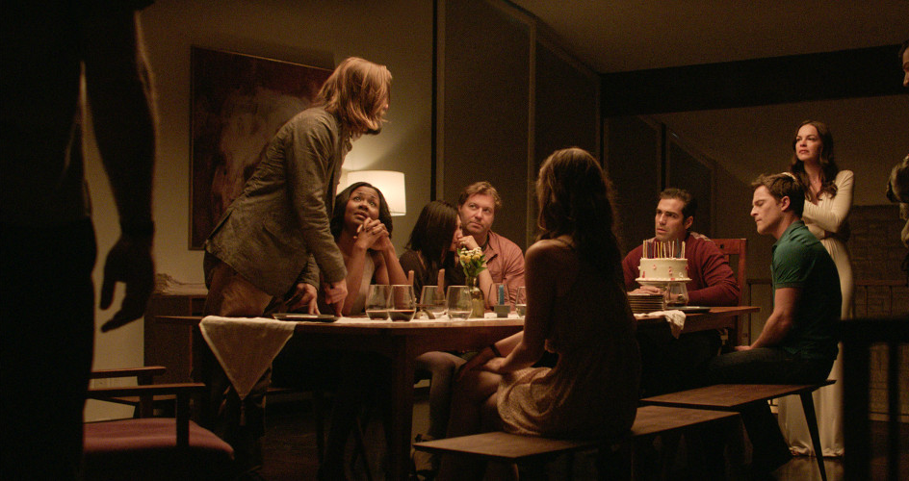
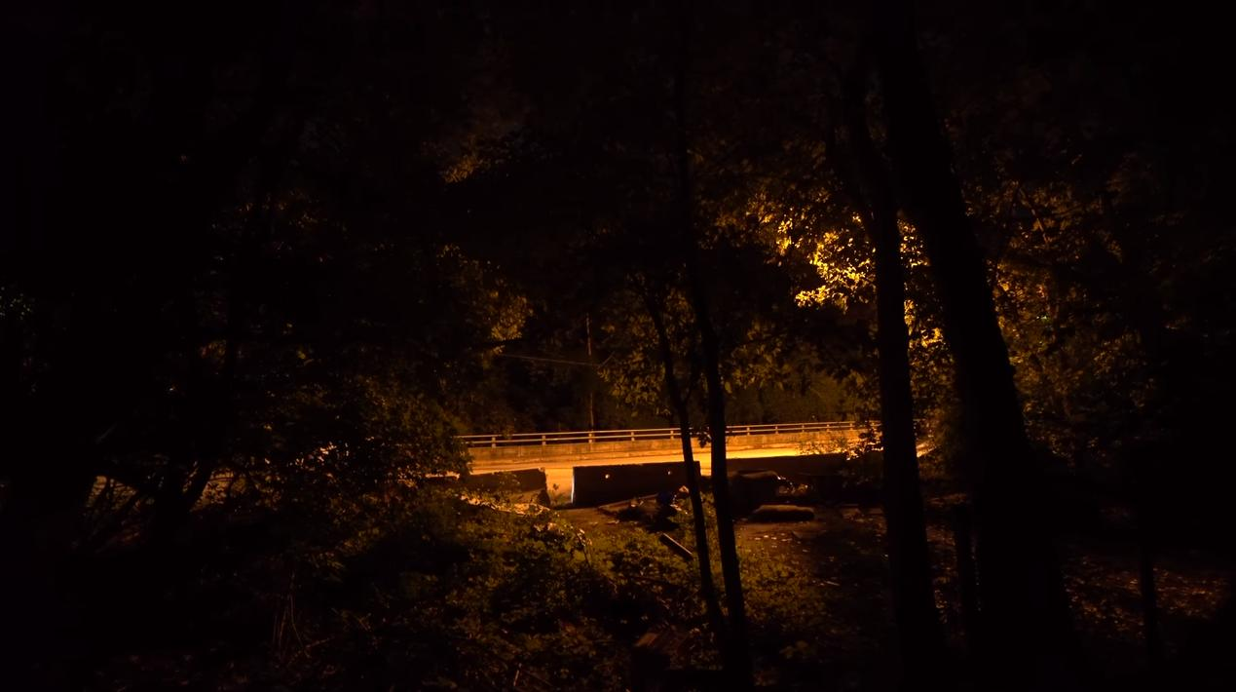
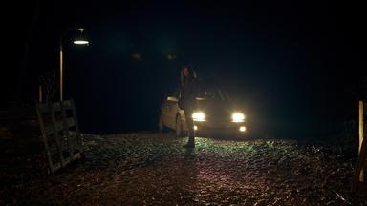
Thriller

Slide 8
Characterisation
Characters in thrillers include convicts, criminals, stalkers, assassins, down-on-their-luck losers, innocent victims (often on the run), prison inmates, menaced women,
Characters with dark pasts, psychotic individuals, terrorists, cops and escaped cons, fugitives, private eyes, drifters, duplicitous individuals, people involved in twisted relationships, world-weary men and women, psycho-fiends, and more.
The themes of thrillers frequently include terrorism, political conspiracy, pursuit, or romantic triangles leading to murder

Slide 9
Task – Character Brainstorming
Create groups of 3-4
Using the genre I will allocate fill in the sheets with the characteristics for the protagonist that would suit the particular genre conventions
Write down how did you come up with these characteristics
Create visual mind map summarising the character traits

Slide 10
Helpful Questions
Would you rather be patient or reliable?
Would you rather be irresponsible or thoughtless?
Would you rather be bossy or lazy?
Would you rather be generous or cooperative?
Would you rather be brilliant or unselfish?
Would you rather be meddlesome or deceitful?

Slide 11
RECAP
Aim: Students will be able to use the conventions of genre to create character for script.
Objectives:
Students should be able to use existing knowledge and apply it using the character sheet and fit it to the specific genre.
Students should be able to create a character in the specific genre and present how they come up with this character.
Students should be able to identify the conventions used to create characters in genre films.

Slide 12
references
https://www.filmsite.org/
https://www.nownovel.com

